Slide 1
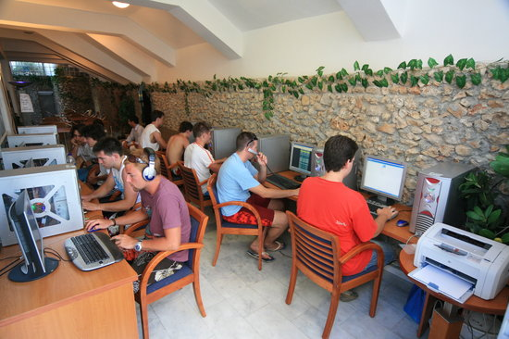
Topic 9: Price discrimination Matěj Bajgar matej.bajgar@fsv.cuni.cz
Microeconomics II
What is it?

Slide 2
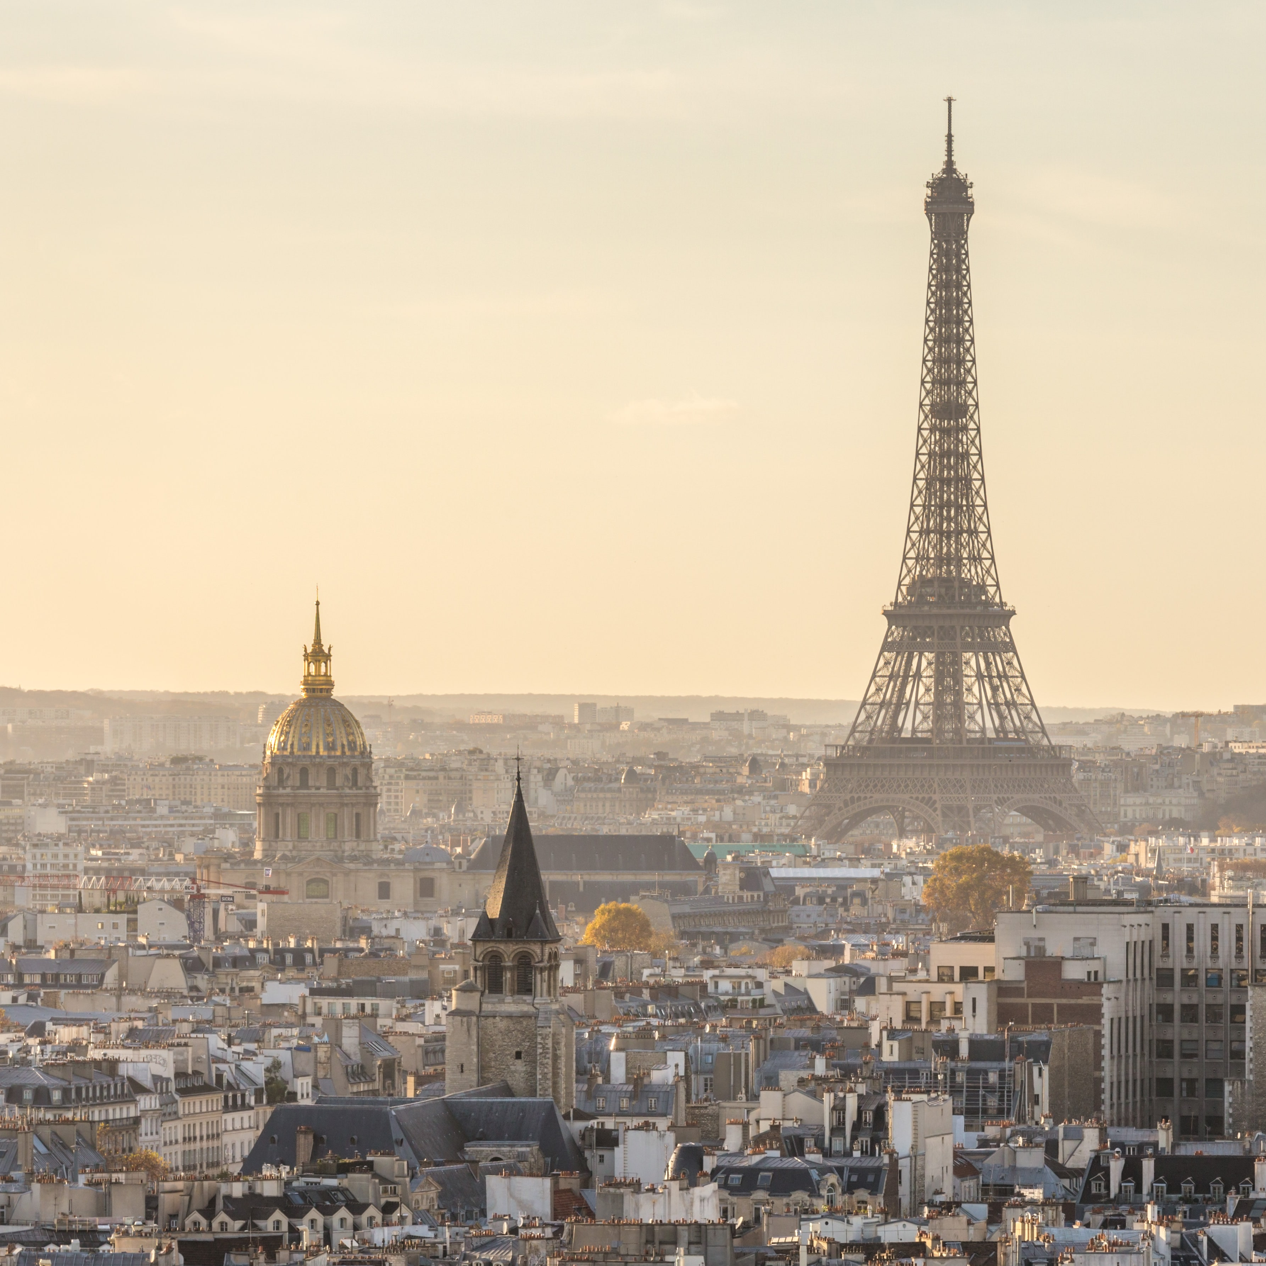
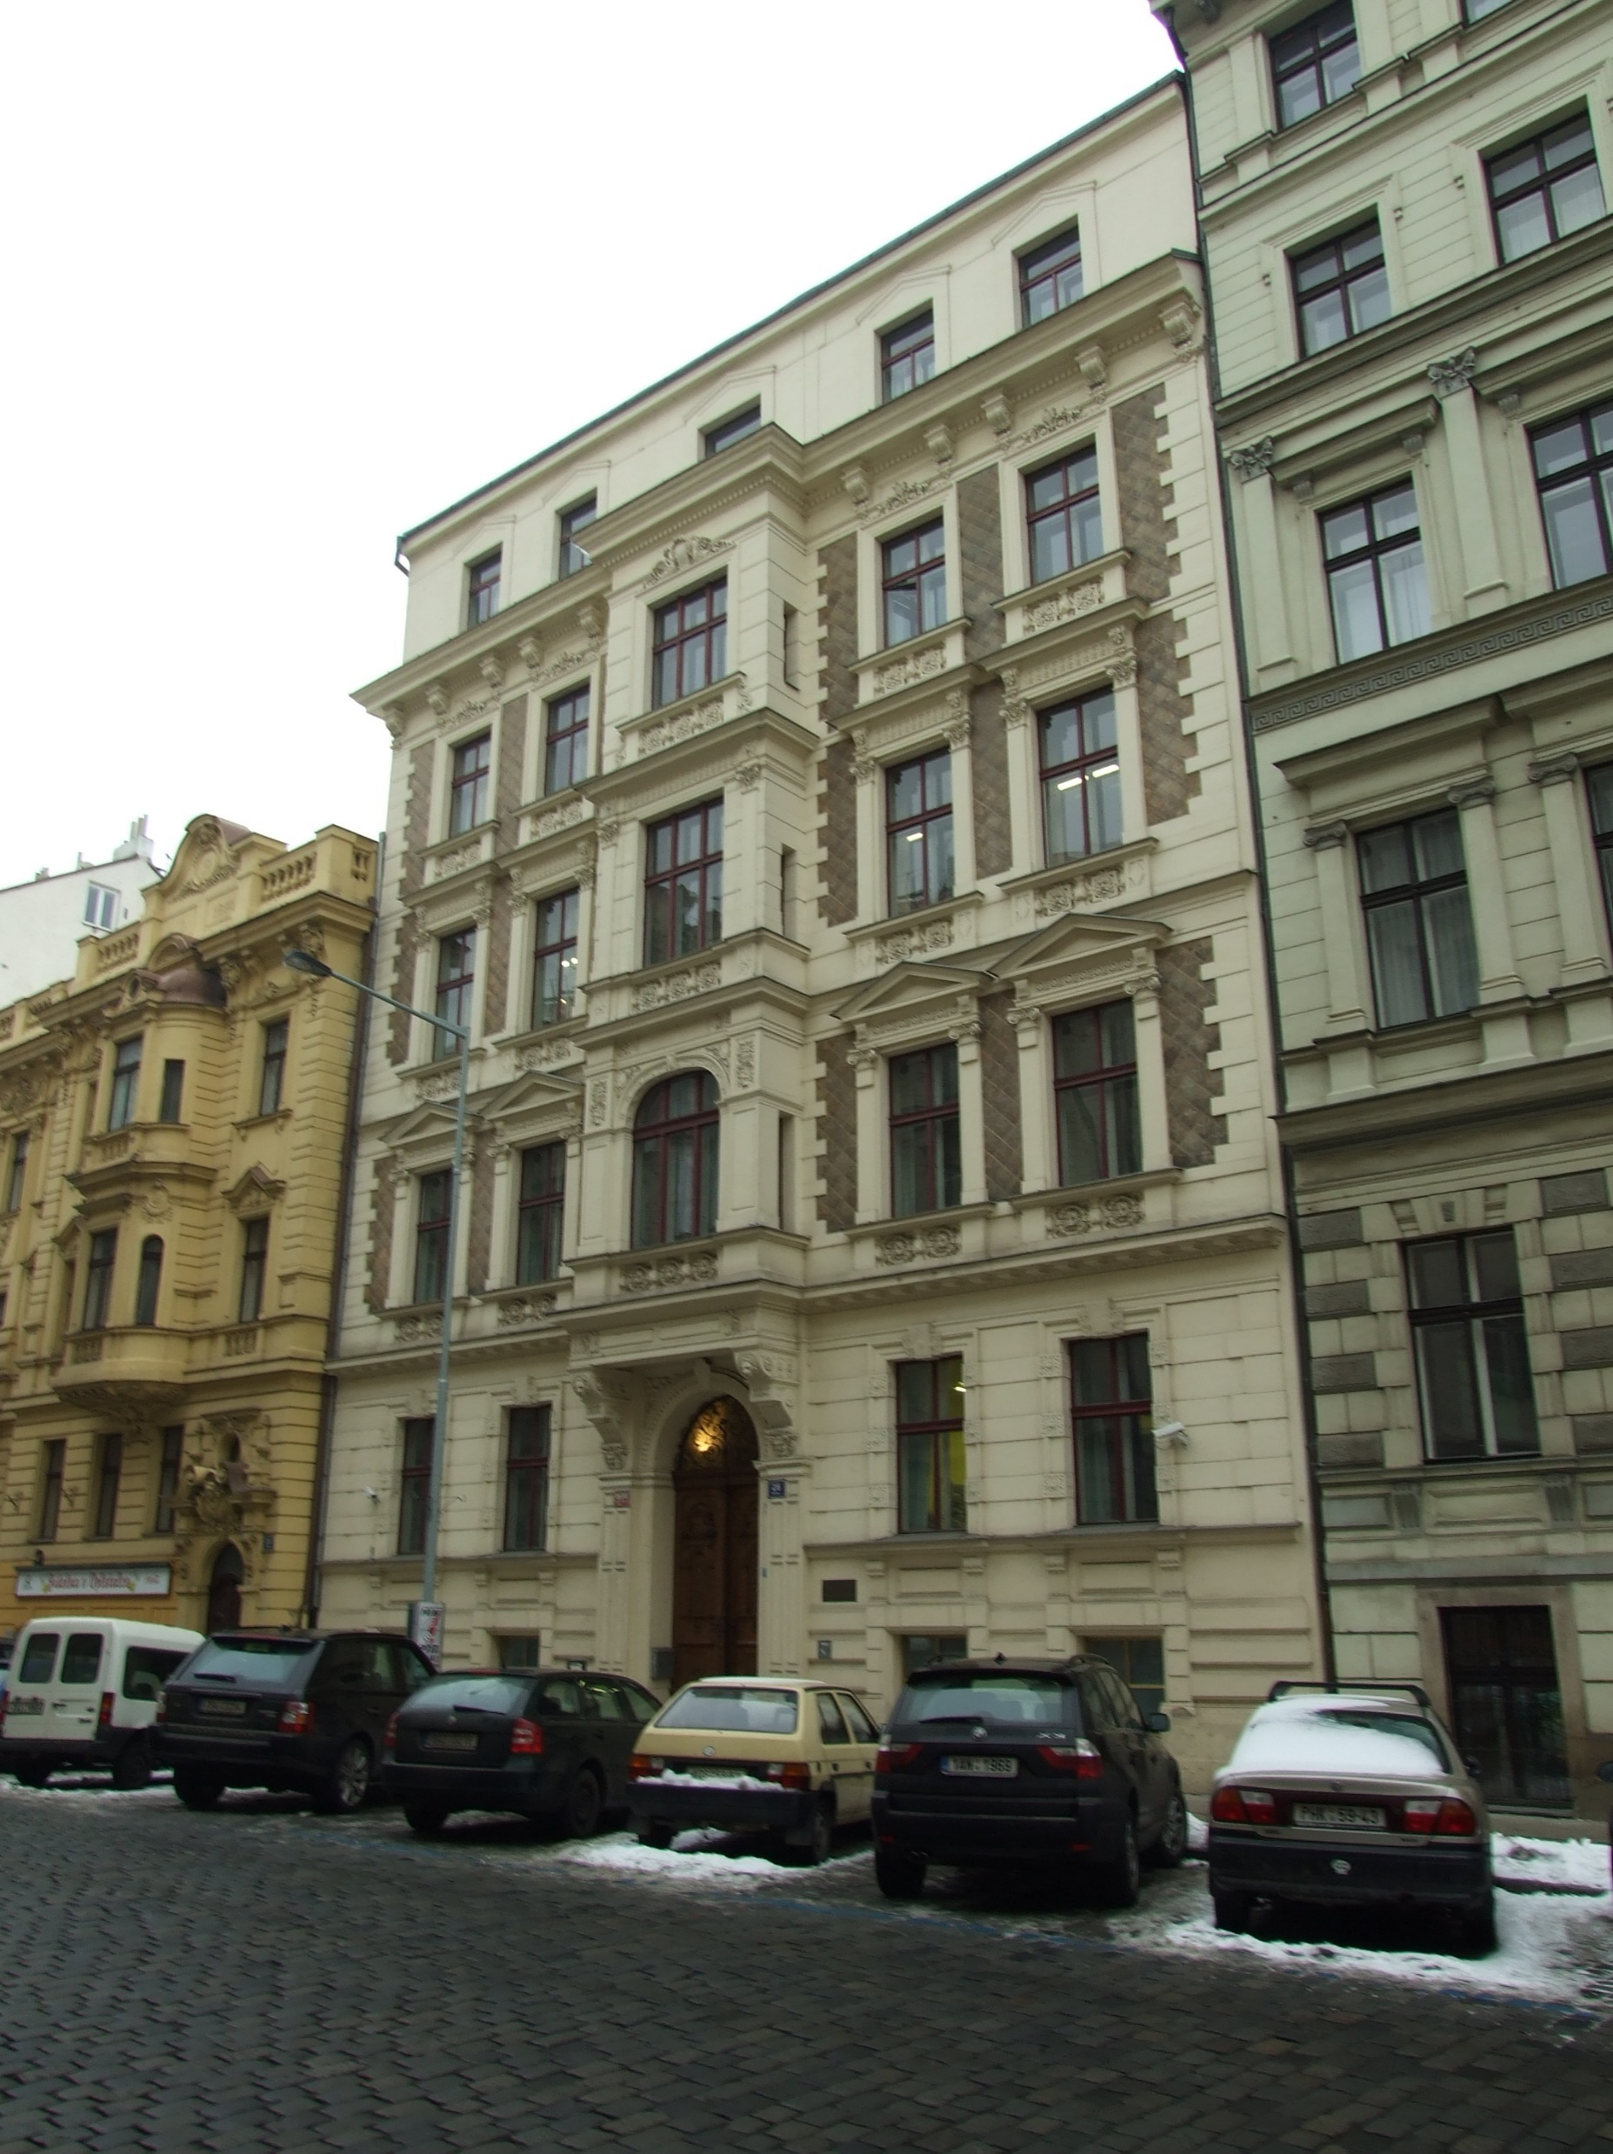
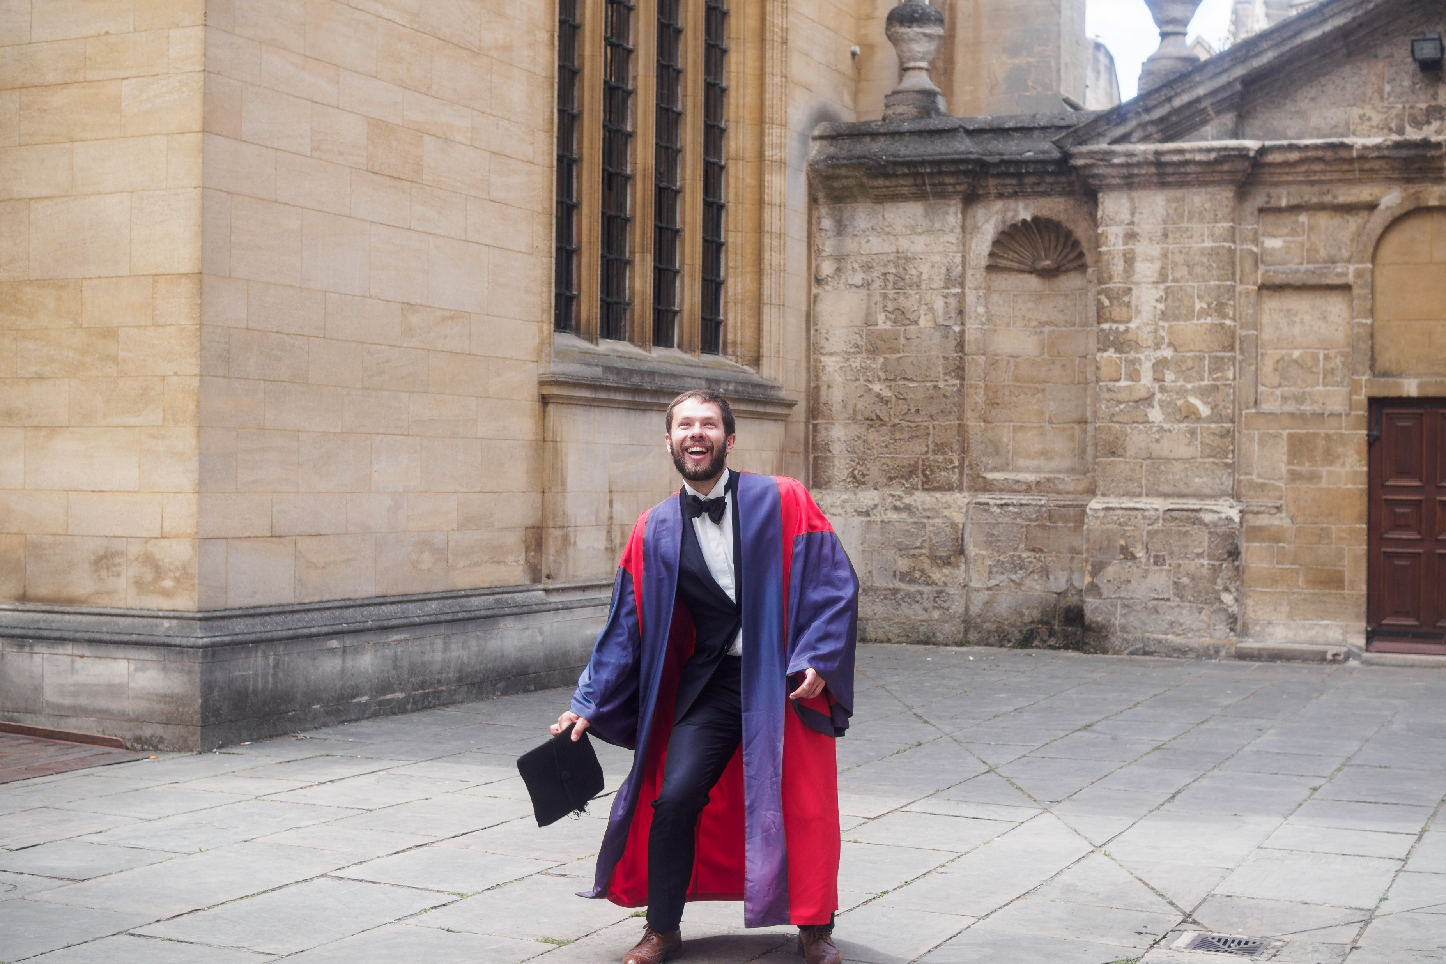

About me

Slide 3
About you

Slide 4
Introduction and roadmap
Price discrimination = selling different units of output at different prices
Roadmap
1st degree price discrimination
2nd degree price discrimination
3rd degree price discrimination
Other pricing strategies
Bundling
Tie-ins
 | 1st degree „perfect discrimination“ | 2nd degree „non-linear pricing“ | 3rd degree „market segmentation“
Different price for different units? | Yes | Yes | No
Different price for different buyers? | Yes | No | Yes
Notes:
The following is a roadmap for this course. Some topics may extend over multiple lectures, and the whole roadmap is subject to change.
Introducing IO
A brief history of antitrust
Quick recap of analysis of perfect competition and monopoly.
Pricing strategies
Why do airlines cancel return ticket if first lag not travelled?
Why do cheap cameras look like crippled expensive cameras?
What was the classic Microsoft Explorer lawsuit about?
Oligopolistic competition
We talk about the standard models of oligopoly (Cournot & Bertrand) but discuss some more subtle features.
When does Bertrand lose its extreme properties?
Why was Cournot key for the Structure-Conduct-Performance paradigm?
Is Bertrand actually Cournot?
Is Jan Tleskač Cournot too?
Anticompetitive strategies
Does it ever pay-off to charge predatory prices?
What does the rise of index investing mean for competition?
Information & advertising
Is advertising socially beneficial?
Is there too much advertising?
Does it matter what the advertisements actually say?
Who pays for Google?
Mergers
Why are mergers paradoxical?
Any similarities of Facebook with Marek Dospiva?
Why are existing merger guidelines obsolete?
R&D & patenting
Why is there not enough R&D (despite of what my father says)?
Why do firms underinvest in long-term research
Why can patenting be too stict or too lenient?
Digital economy
Can there be competition problem with p=0?
Is Facebook a public utility?
Is it ok if Booking.com prohibits hotels from offering direct bookings cheaper?
Save Net Neutrality?

Slide 5
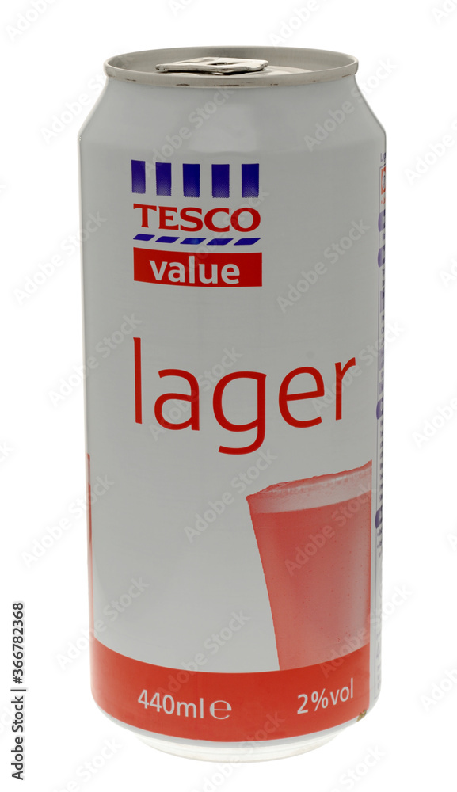
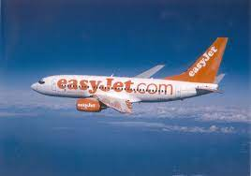

Motivation
Understand pricing strategies by real-world companies
Important implications for regulation and anti-trust

Slide 6
1st degree price discrimination
„Perfect discrimination“
Definition
Price different for different individuals and different units

Slide 7
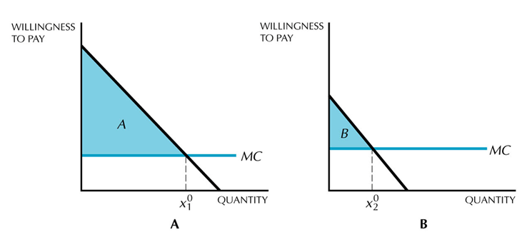
1st degree price discrimination
Analysis
Each unit sold at each consumer’s reservation price.
Similar to selling a fixed amount of good at ”take it or leave it” price.
For the last sold unit P = MC ➔ Efficient (like perfect competition)
No consumer surplus ➔ All surplus goes to the seller (very much unlike perfect competition!)

Slide 8
1st degree price discrimination
Key assumptions
Arbitrage not possible
Seller knows each consumer’s demand schedule

Slide 9




1st degree price discrimination
“Perfect discrimination” rare in practice but some examples are...
University tuition in the US
Accountant, lawyer, consultant, therapist...
Proprietary data
?

Slide 10
2nd degree price discrimination
„Non-linear pricing“ or „menu pricing“
Definition
Price different for different units but the same across individuals
The key point is consumers self-select into the quantity or the specification

Slide 11
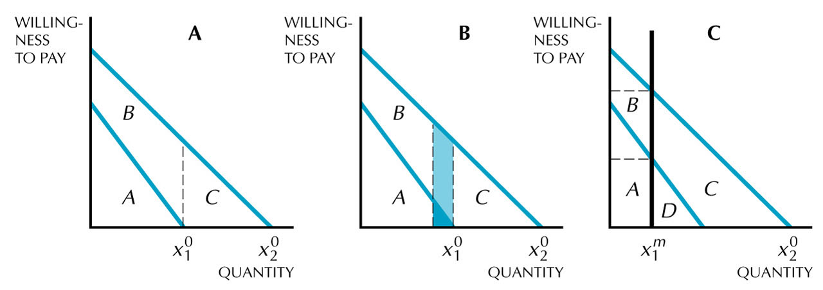
2nd degree price discrimination
Analysis
Assume: MC=0, consumers 1 (low willingness to pay, WTP) and 2 (high WTP)
The seller would like to sell
to consumer 1: quantity x₁ for price A
to consumer 2: quantity x₂ for price A+B+C
...but consumer 2 has an incentive to pretend to be consumer 1
Profit = 2A
Notes:
Consumer 2
If he buys x2, he has zero surplus
If he buys x1, he gets surplus B
T

Slide 12
2nd degree price discrimination
Analysis
The seller offers a menu: charge A for x₁ and A+C for x₂
➔ consumers self-select into x₁ and x₂
But the seller can further increase profits by reducing x₁
Profit = 2A + C
Notes:
Consumer 2
If he buys x2, he gets B
If he buys x1, he gets B
Consumer 1
If he buys x1, he gets 0
If he buys x2, he gets –C
Profit = 2A + C
If reducing x1, profit on consumer 1 goes down by dark blue area but profit on consumer 2 goes up by the dark+light blue areas.

Slide 13
2nd degree price discrimination
Analysis
The seller offers a menu: charge A for x₁ and A+C for x₂
➔ consumers self-select into x₁ and x₂
But the seller can further increase profits by reducing x₁
Optimum: the marginal reduction in profit on consumer 1 equals the marginal increase in profit on consumer 2

Slide 14
2nd degree price discrimination
Implications
Consumer 1 (low WTP) has no surplus
Consumer 2 (low WTP) has a strictly positive surplus = B
For the last unit sold to consumer 2, P = MC ➔ Efficient
For the last unit sold to consumer 1, P > MC ➔ Inefficient

Slide 15
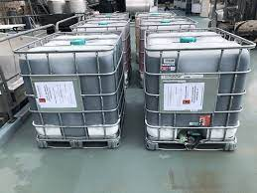
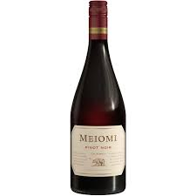
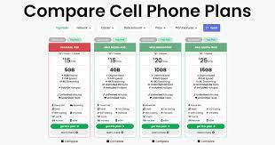
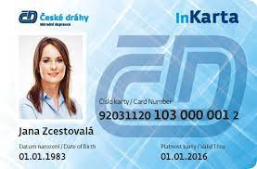
2nd degree price discrimination
Examples
Bulk discounts
Cell-phone plans
Discount cards (IN25/50)

Slide 16


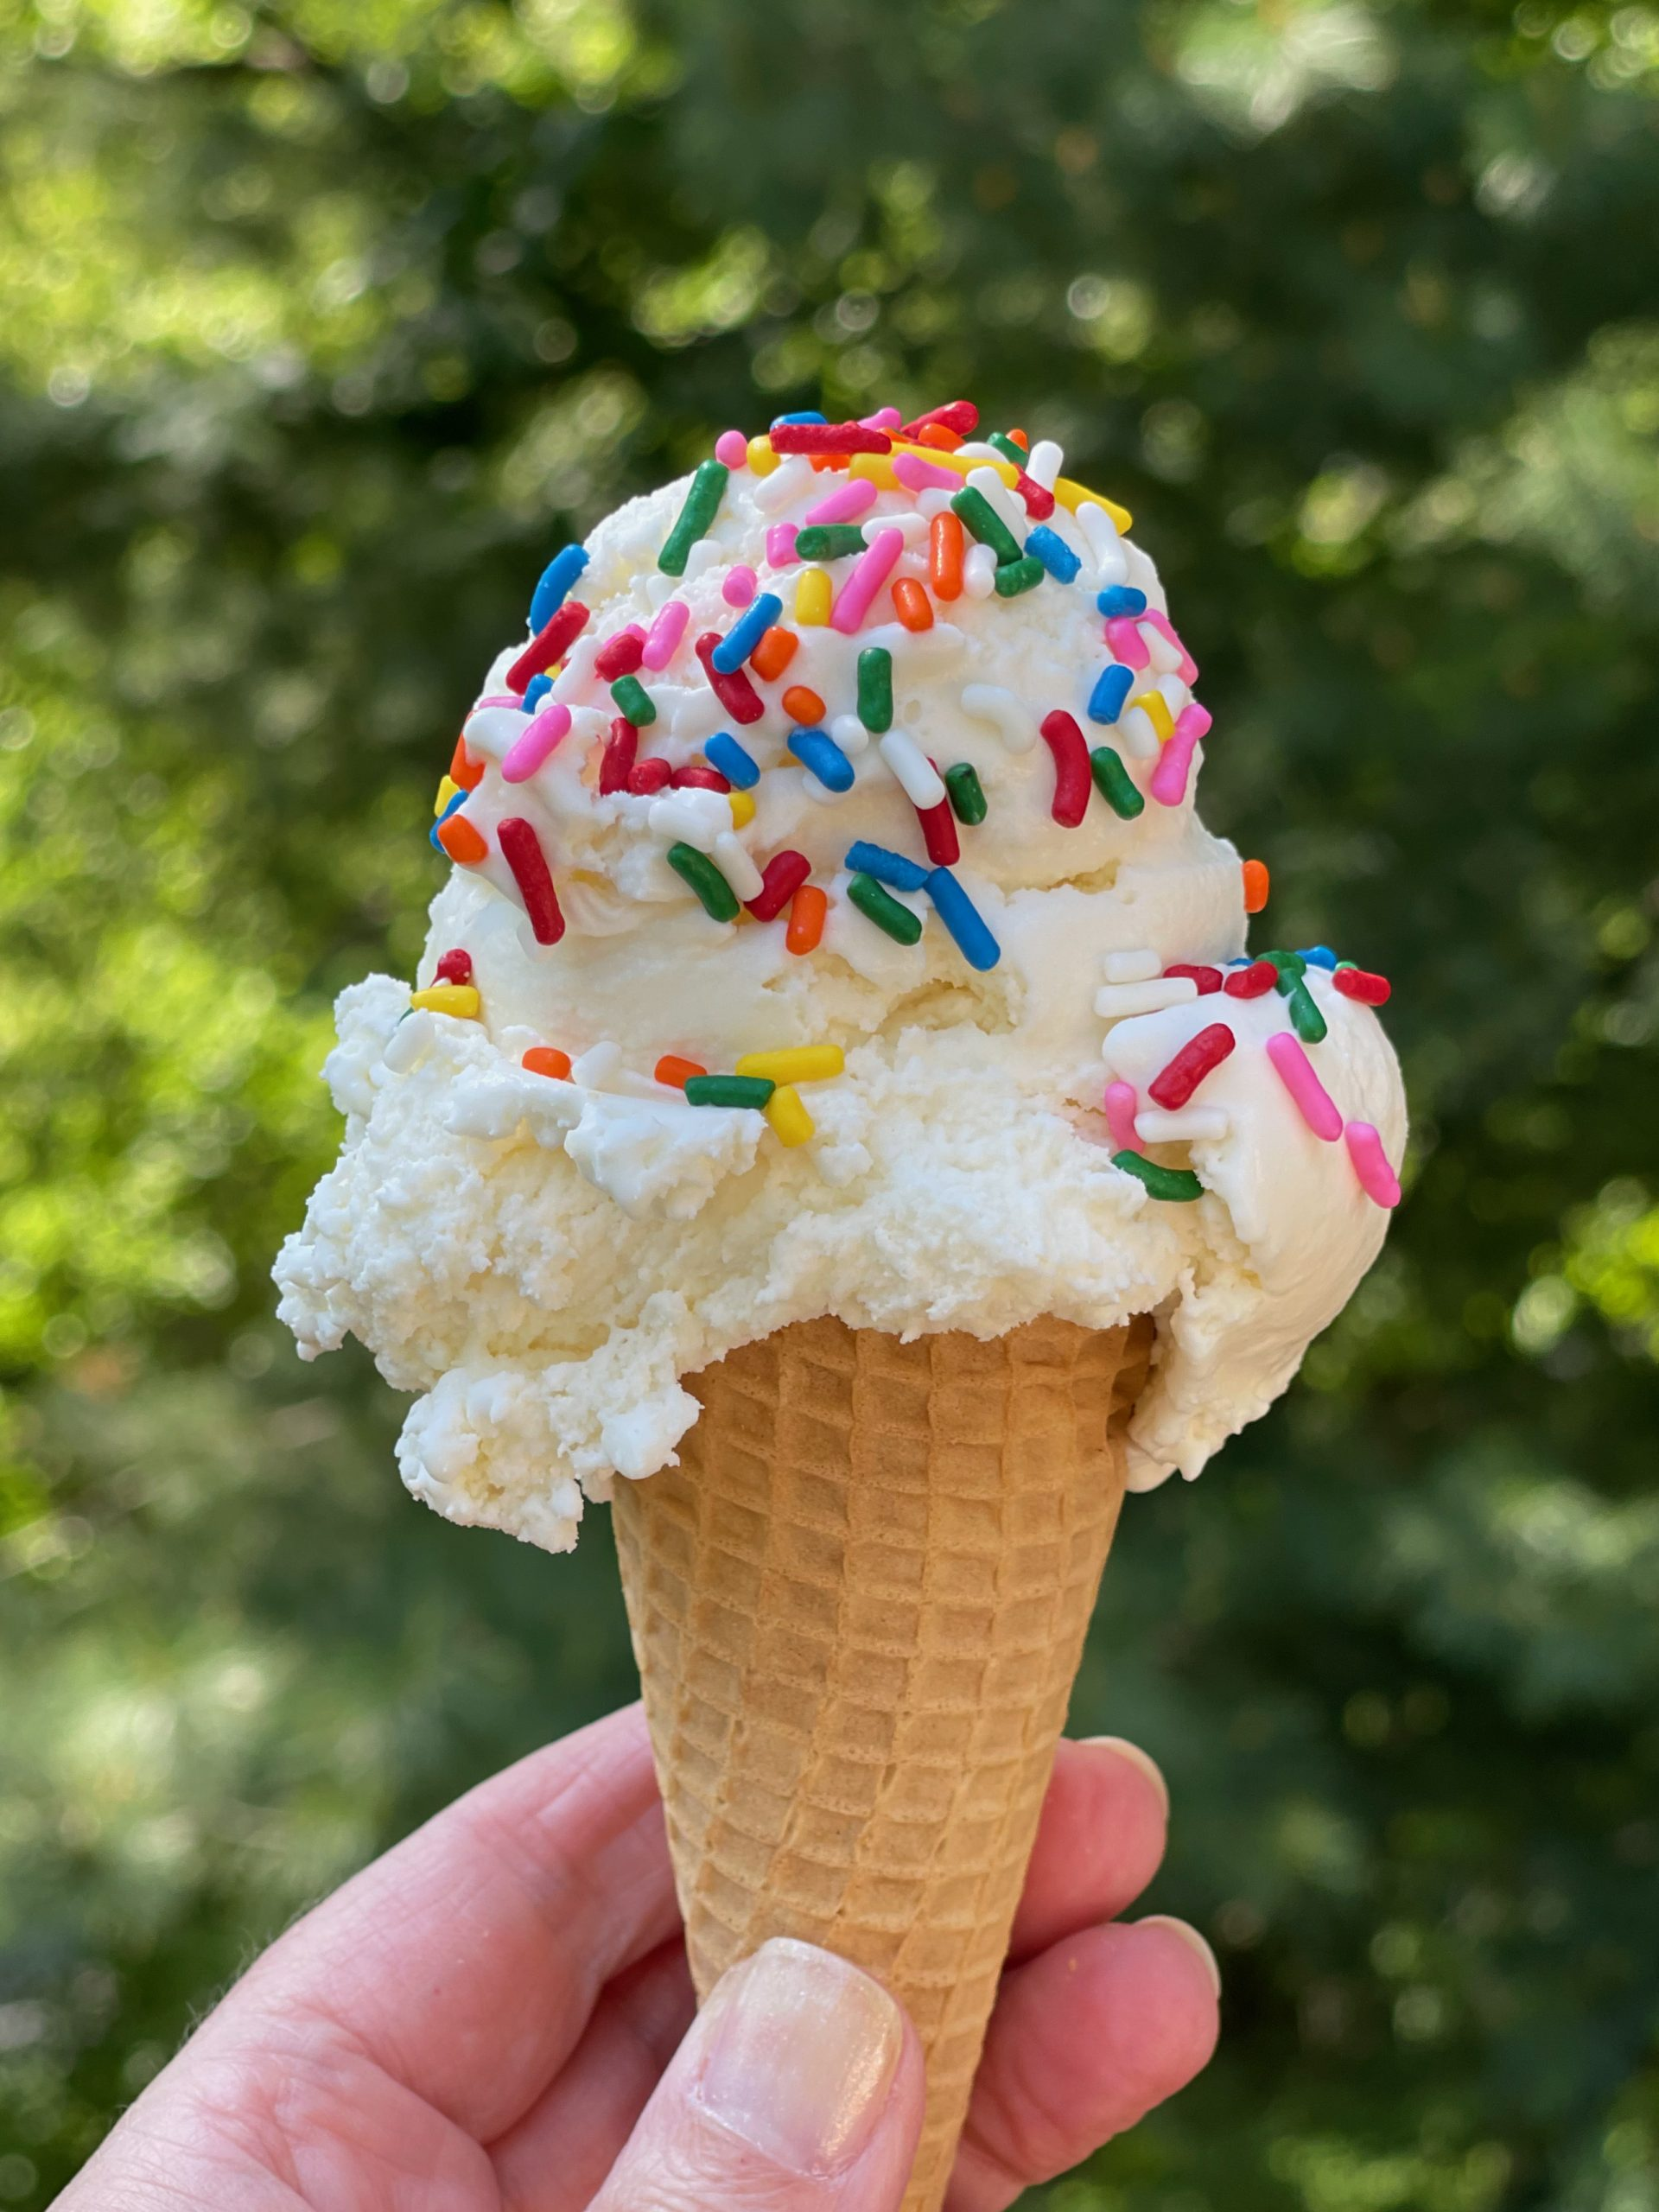
2nd degree price discrimination
The quality interpretation
Products with different featues rather than different quantity
Cheaper versions sometimes made intentionally worse, even at extra costs
Examples:
Electronics
Business vs. Economy flights
Eg. Saturday night stayover, boarding
Premium features
Enthusiast camera Professional camera

Slide 17
3rd degree price discrimination
„Market segmentation“
Definition
Price different for different individuals but the same across units
Assumptions:
Seller able to identify the different (groups of) individuals
Seller able to prevent arbitrage

Slide 18
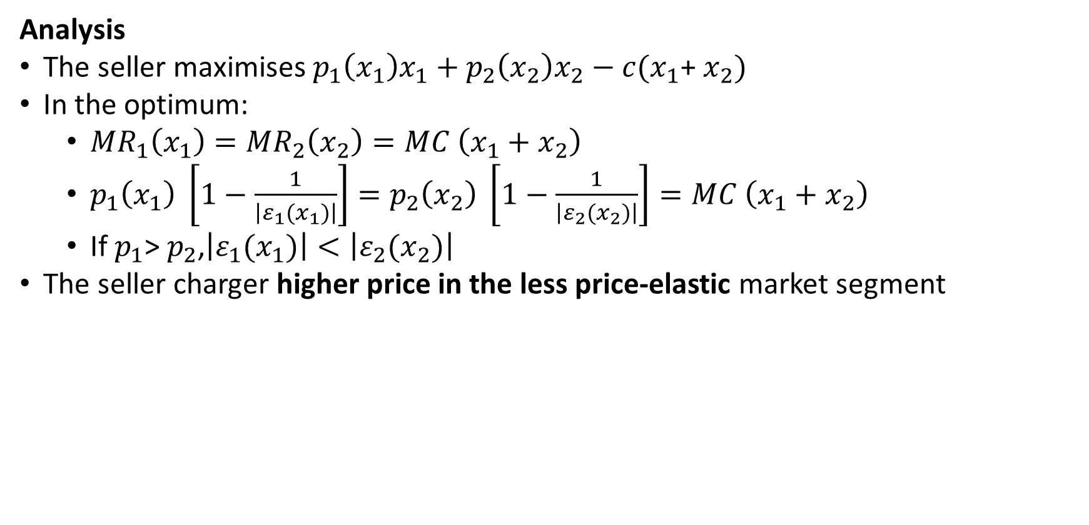
3rd degree price discrimination
Analysis
The seller maximises $p_{1}\left(x_{1}\right)x_{1}+p_{2}\left(x_{2}\right)x_{2}−c(x_{1}$+ $x_{2})$
In the optimum:
${MR}_{1}\left(x_{1}\right)={MR}_{2}\left(x_{2}\right)=MC \left(x_{1}+x_{2}\right)$
$p_{1}\left(x_{1}\right) \left[1−\frac{1}{\left|ε_{1}(x_{1})\right|}\right]=p_{2}\left(x_{2}\right) \left[1−\frac{1}{\left|ε_{2}(x_{2})\right|}\right]=MC \left(x_{1}+x_{2}\right)$
If $p_{1}$> $p_{2}$,$\left|ε_{1}(x_{1})\right|<\left|ε_{2}(x_{2})\right|$
The seller charger higher price in the less price-elastic market segment

Slide 19
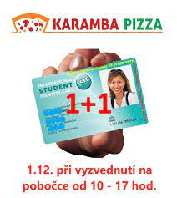
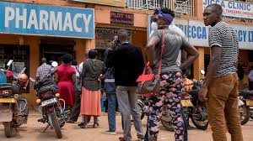
3rd degree price discrimination
Examples
Student discounts
Pharmaceuticals
?

Slide 20
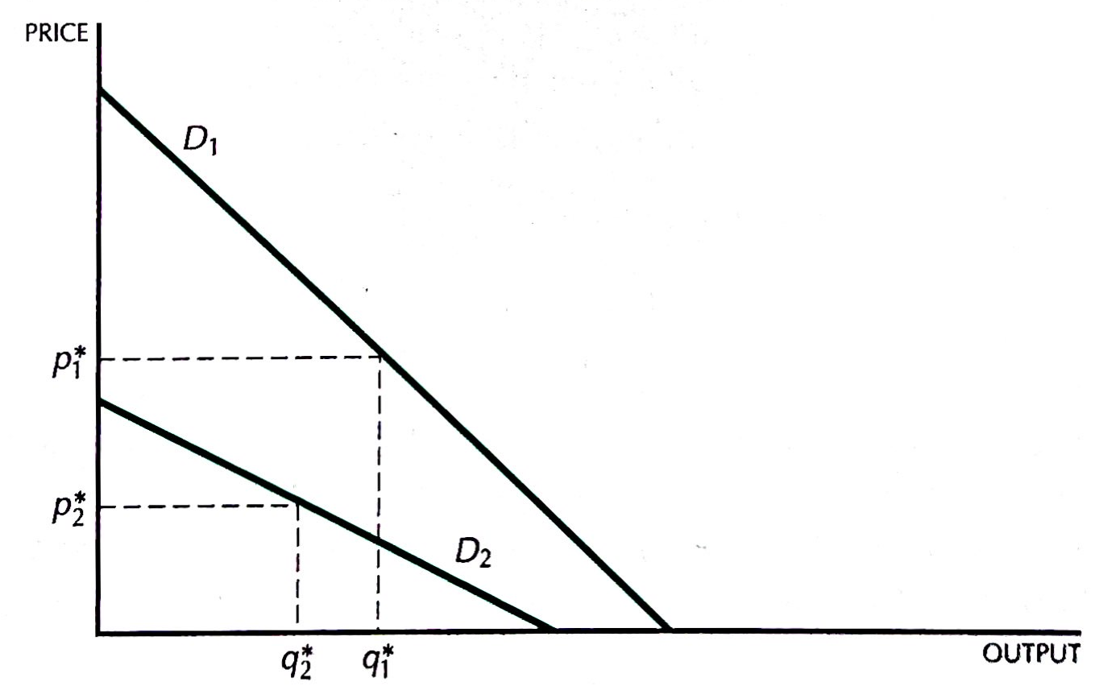
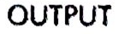
3rd degree price discrimination
Are all markets served without discrimination?
Setup
Market 1 (high demand): x₁=a-bp₁
Market 2 (low demand): x₂=c-dp₂
MC = 0
If selling in both markets w/o discrimination
Discrimination: x₁* = a/2, x₂* = c/2
No discrimination: x* = (a+c)/2
➔ Output the same with and w/o discrimination
If selling only in market 1 w/o discrimination
Discrimination: x₁* = a/2, x₂* = c/2
No discrimination: x* = a/2
➔ Output greater with discrimination

Slide 21

3rd degree price discrimination
Exercise
Setup
Market 1 (high demand): x₁=100-p₁
Market 2 (low demand): x₂=60-2p₂
MC = 20
Questions:
If they can discriminate:
What price will they charge in each market?
What will be the total output?
If the seller cannot discriminate:
Will they sell in both markets?
What will be the total output

Slide 22
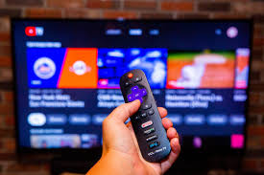
Bundling
Bundling = selling multiple products in fixed proportions as a package
Examples:
TV channel bundles
TVs purchasing programmes from distributors
Microsoft Office
Set menues in restaurants
Machinery+maintenance packages
2 TV channels: CNN, Eurosport
2 types of customers: serious guy, sports fan
Without bundling, it is optimal to charge 5000 for each channel ➔ profit = 10000
But selling bundles for 6000 ➔ profit = 12000
Works well if relative WTP (across different products) varies across individuals.
 | Serious guy | Sports fan
CNN | 5000 | 1000
Eurosport | 1000 | 5000

Slide 23
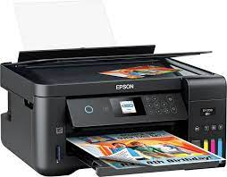
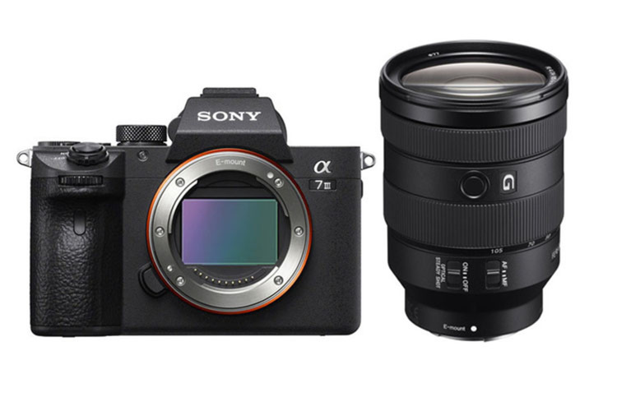
Tie-in sales as price discrimination
Tie-in sales = selling products that require each other but not in fixed proportions
Examples
Printers and cartridges
Cameras and lenses
2 types of customers:
ocassional printers (low WTP)
frequent printers (high WTP)
Each type of customers needs only 1 printers and has similar print quality requir.
➔ 2nd degree discrimination not an option
By requiring original cartridges, producer can
reduce the price of the printer and
extract the surplus through the cartridges
Intuition: differential demand for printing used to discriminate between the customers

Slide 24
Please get in groups of 3

Slide 25
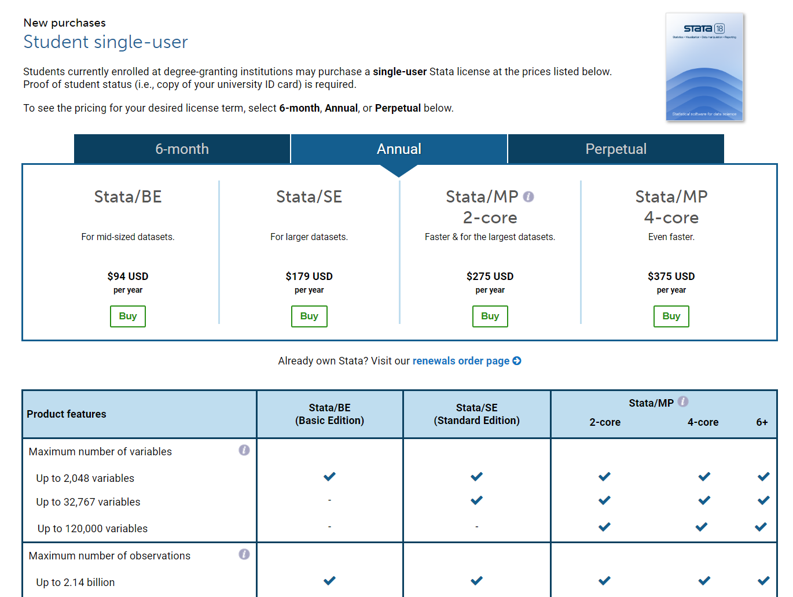
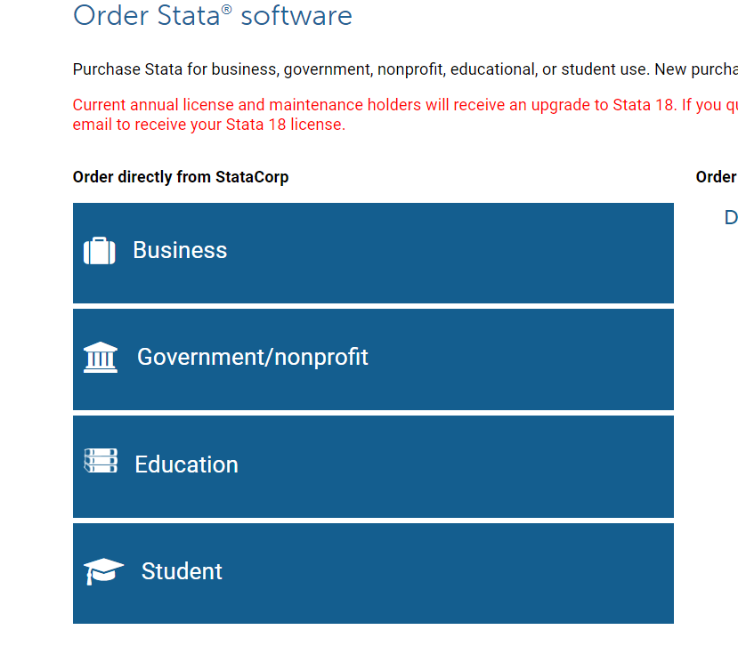
Quiz
What type(s) of price discrimination is it an example of?
Notes:
3rd degree and 2nd degree

Slide 26

Quiz
Why do airlines charge much more for tickets purchased at the last minute, while Broadway theaters follow the opposite practice?
What type of price discrimination is it an example of?
Notes:
2nd degree

Slide 27
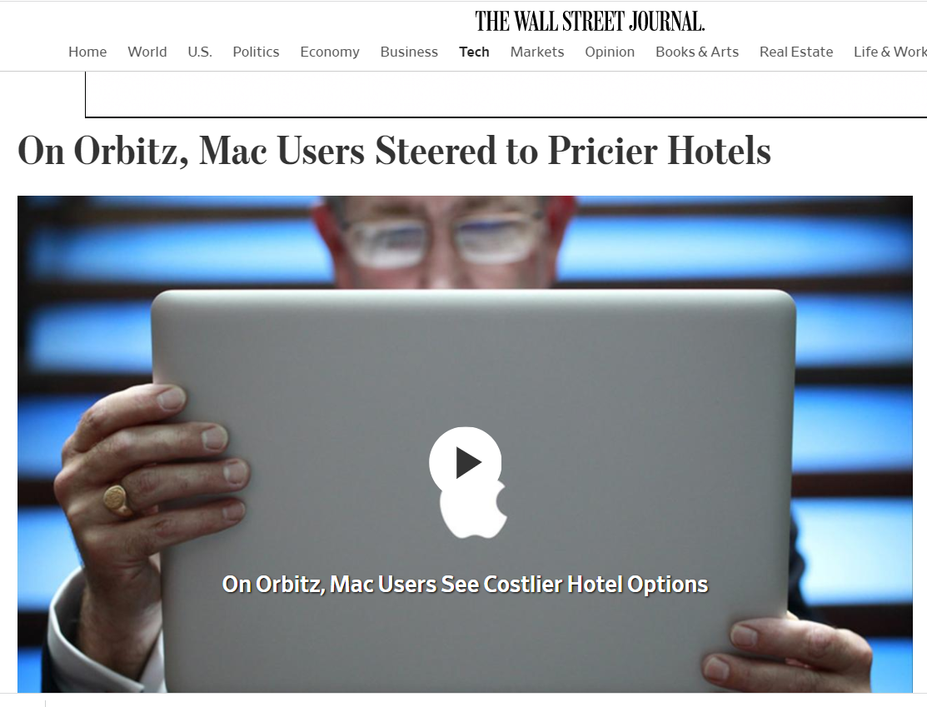
Quiz
https://www.wsj.com/articles/SB10001424052702304458604577488822667325882
What type(s) of price discrimination is it an example of?
Notes:
3rd degree

Slide 28
Quiz
What type(s) of price discrimination is it an example of?
Notes:
3rd degree

